Slide 1
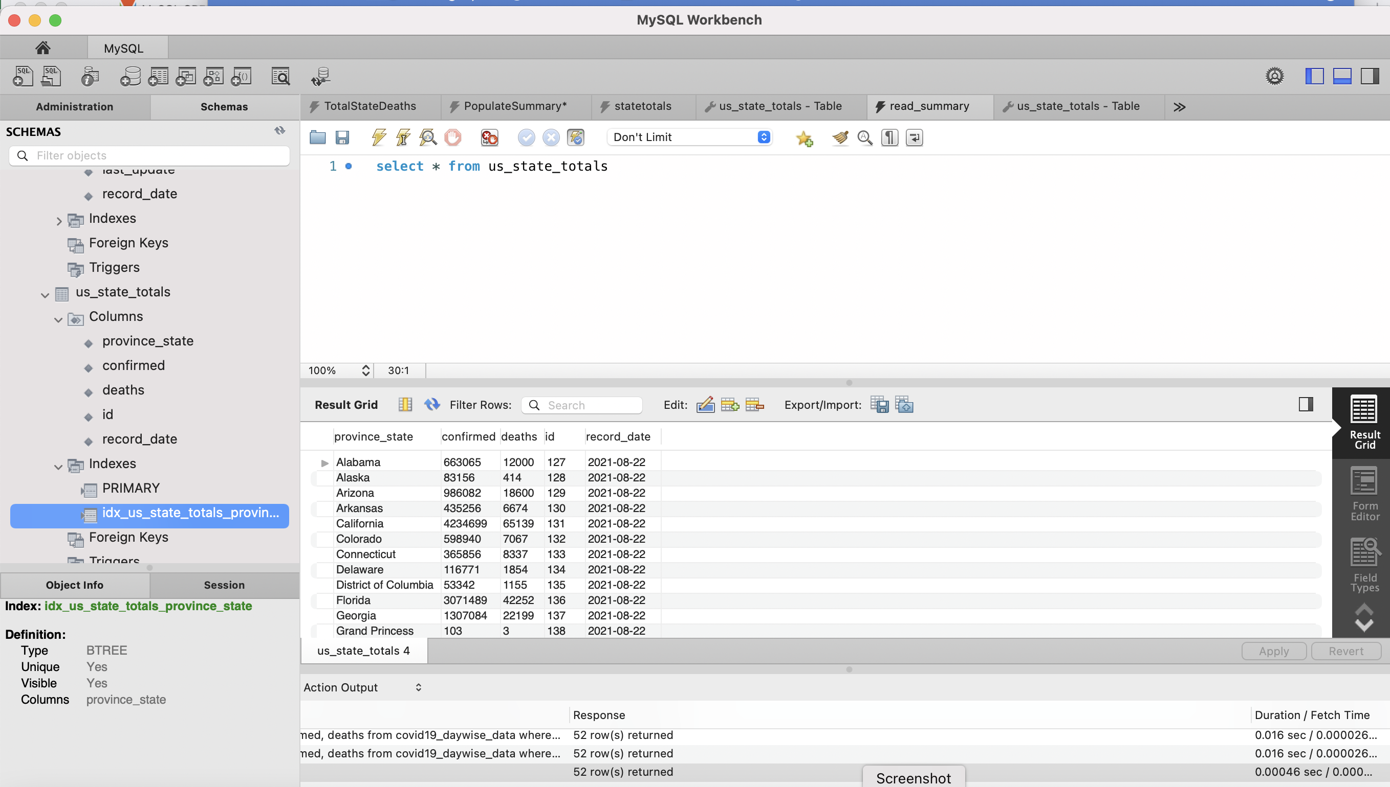
How to use SQL with large datasets
Dave Dalsveen

Slide 2
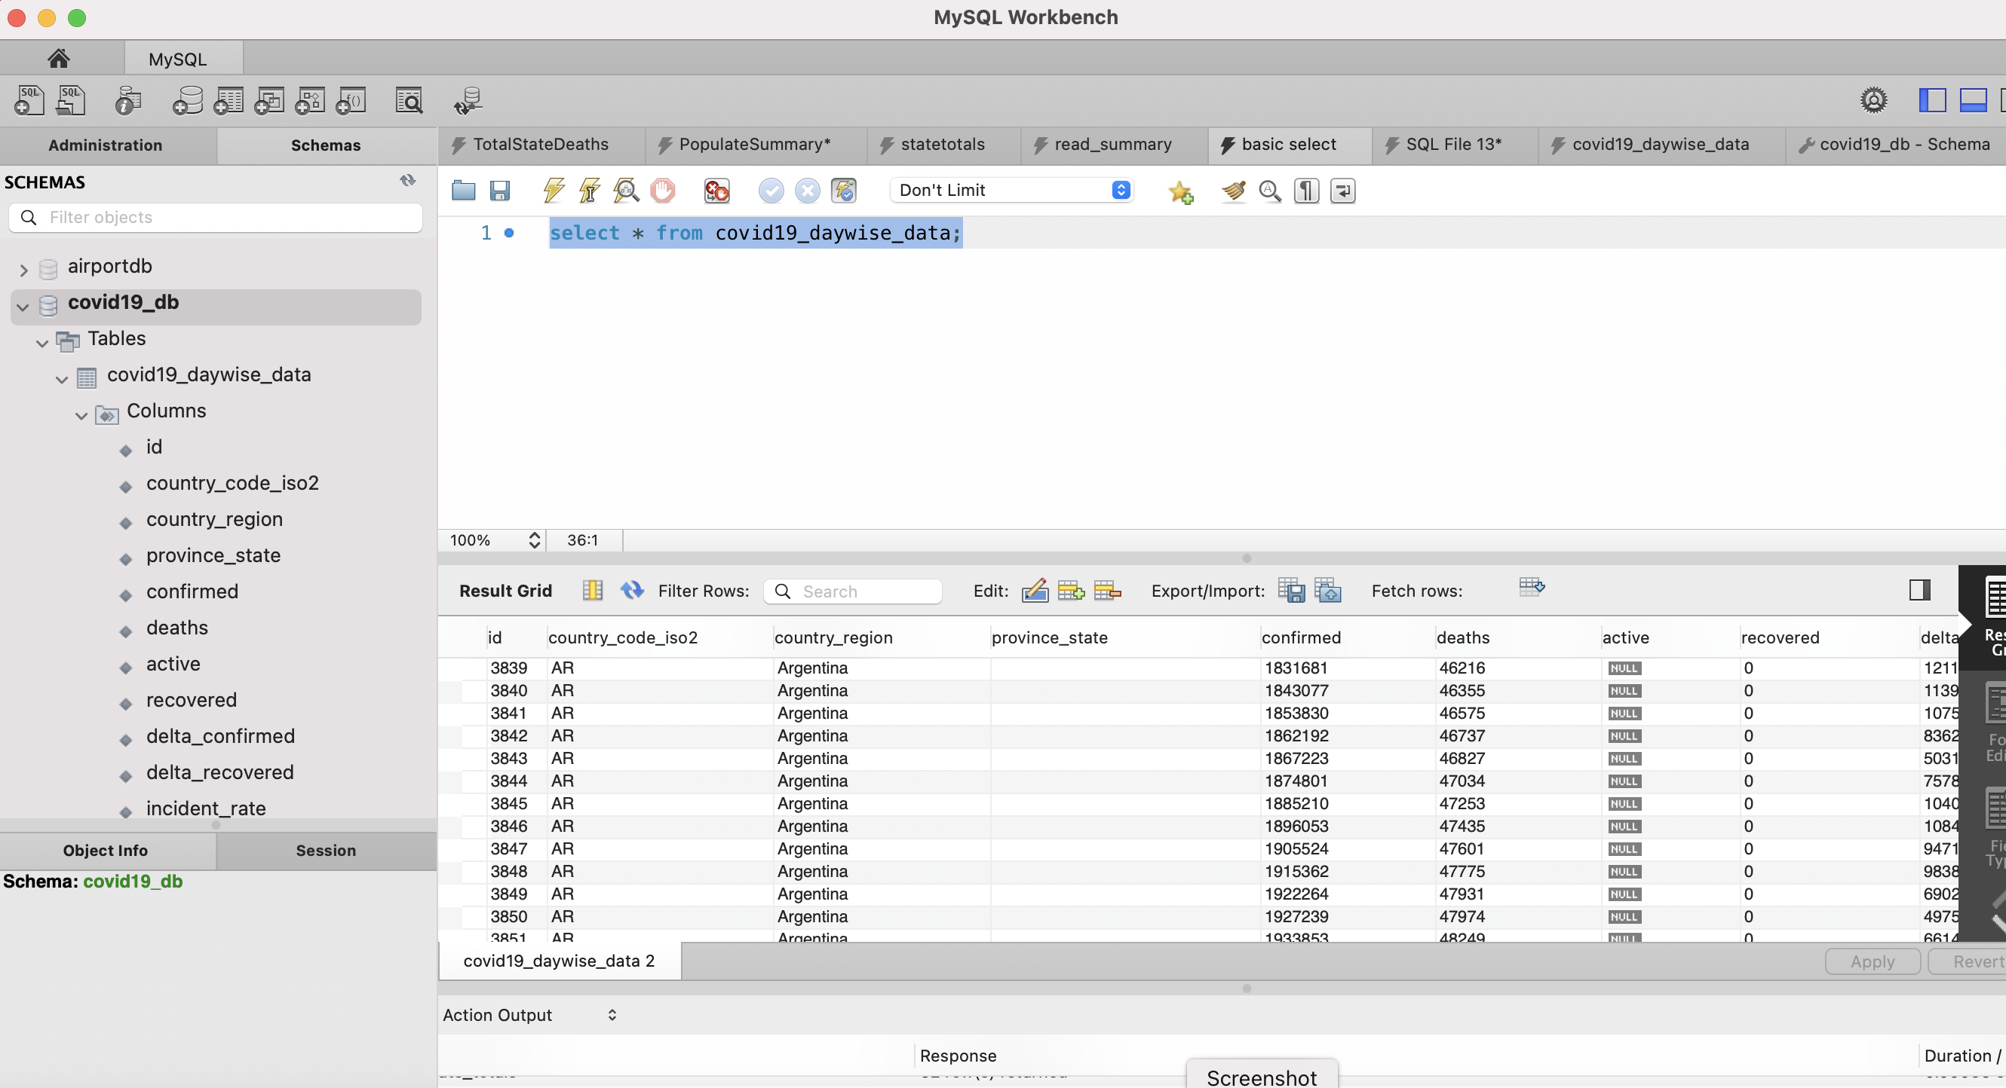
Task1: Analyze an existing dataset.
Connect to the database from MySQL workbench.
Observe the covid19 database and covid19 daily table.
Created by Md. Mahabubur Rahman under MIT license https://choosealicense.com/licenses/mit/ .
Data aggregated from Johns Hopkins by Mr. Rahman available on GitHub. https://github.com/mahabub81/covid-19-api/blob/master/covid-19-mysql-dump/covid19_daywise_data.sql

Slide 3
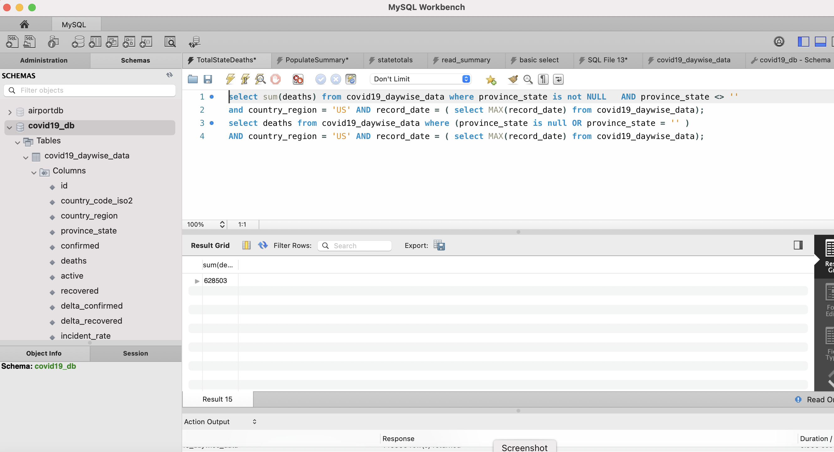
Task2: Create queries to verify data values.
Create a query to select US totals.
Check if sum of state totals match US total.
Check for valid state names.

Slide 4
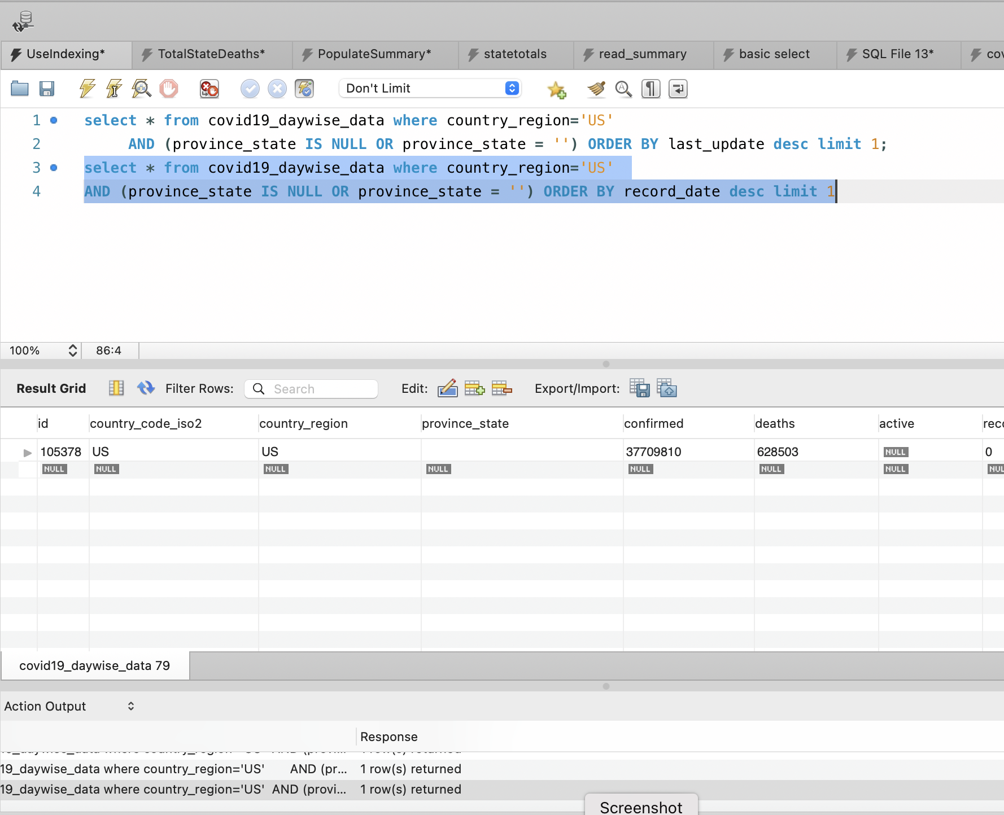
Task3: Create an SQL index to improve query performance .
Try a query without an index.
Add an index for update date.
Retry the same SQL.
Check time difference.

Slide 5
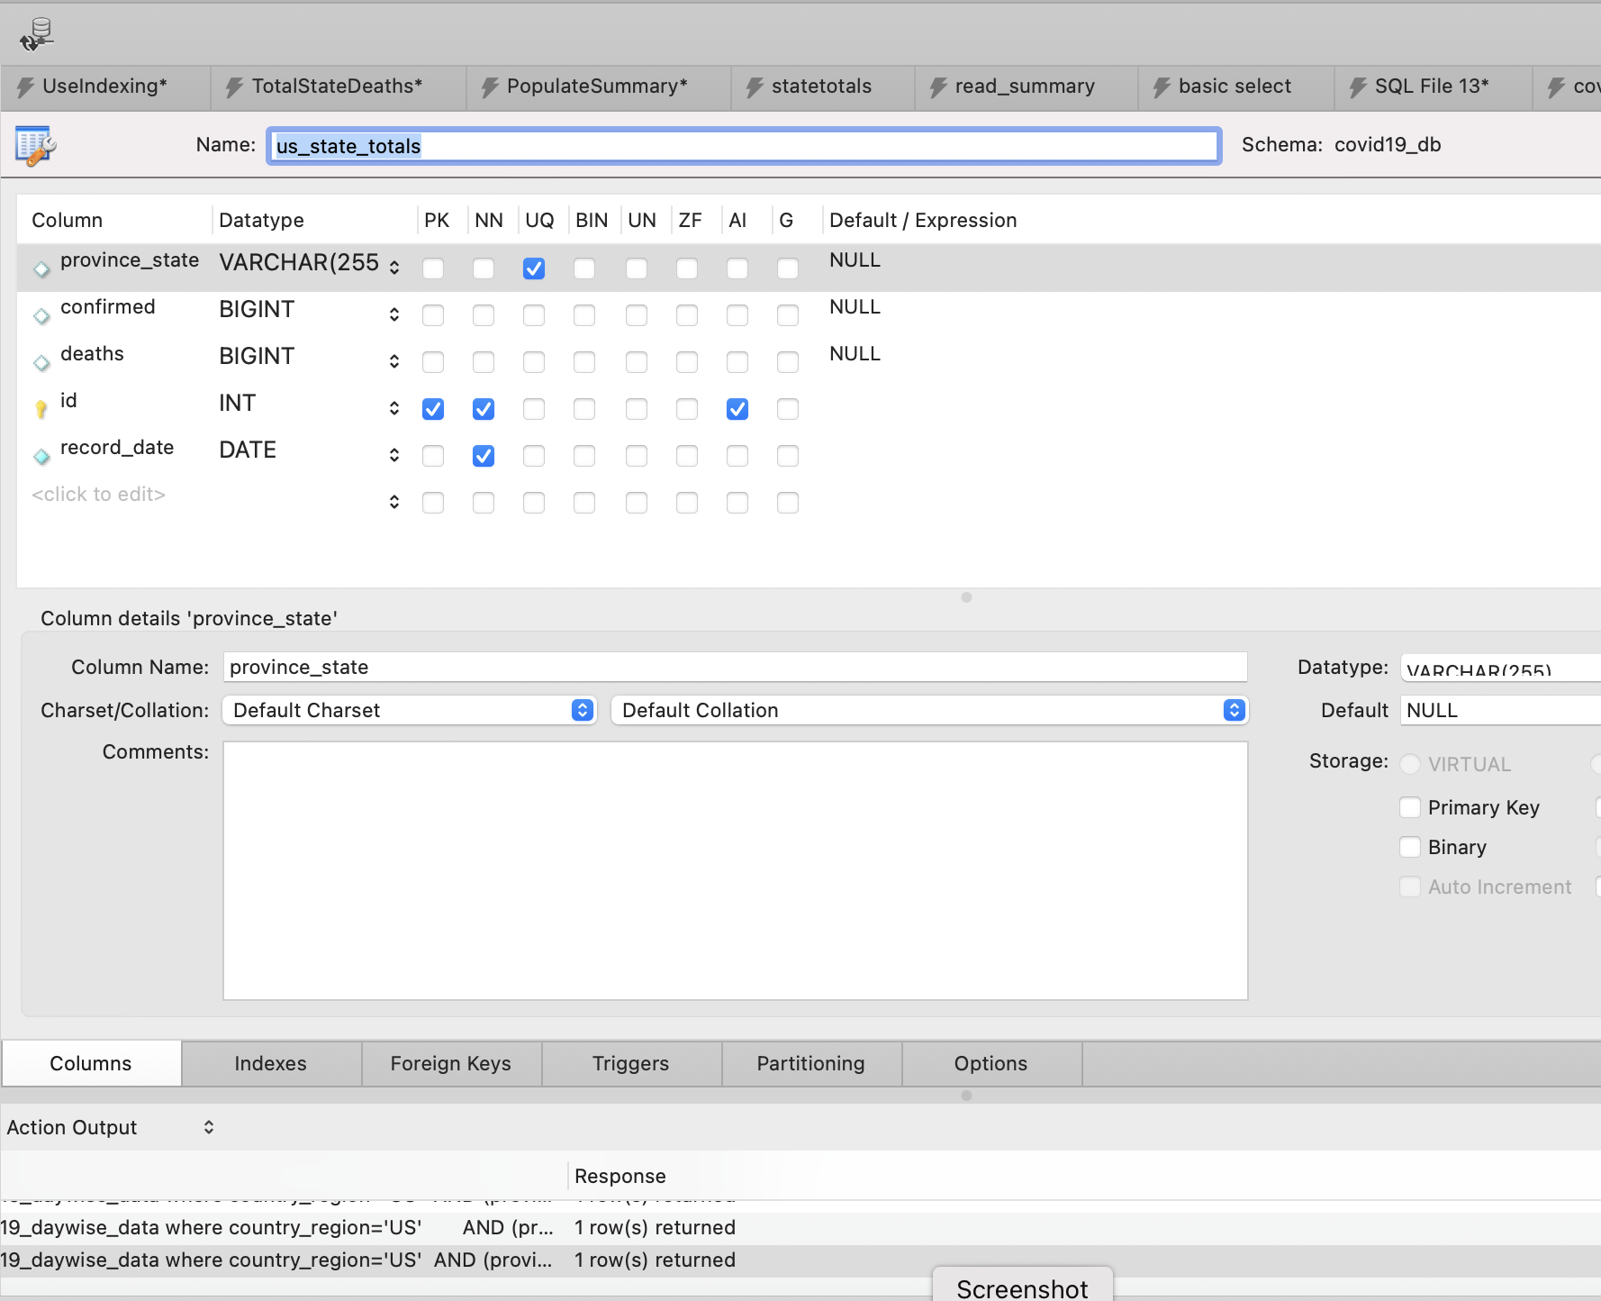
Task4: Create a Summary database table for specific data.
Create a new table within the database.
The table will house the latest totals from states.
Pay attention to the names, so the user knows where the data came from.
Greatly improves performance.
Similar methodology in data Warehousing.

Slide 6
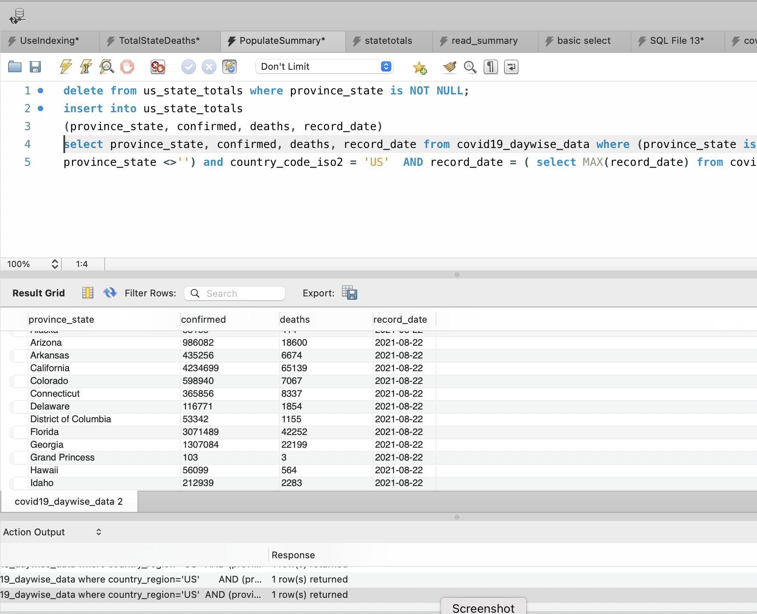
Task5: Populate the summary table using SQL.
Create the insert SQL for the summary table:
Use the select statement to gather corresponding data from the original table.
Add a delete before the insert to refresh rows when main table updates.
Sufficient for infrequent updates.

